Slide 1


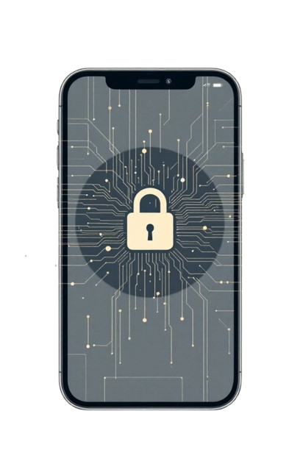

Mobile App Security Testing Using Automated Testing Tools
Presented By:
Abhinash Swain
Swastik Ranjan Sahoo
Rituraj Kumar Sharma
Suranjit Shaw

Slide 2
Table of Content
Introduction
Project Overview
Importance of Automated Security Testing
Tools Used for Automated Security Testing
Challenges and Limitations
Examples
Future Direction/Solution
Conclusion

Slide 3
Introduction
Definition: Mobile App Security Testing is the process of identifying vulnerabilities in mobile apps.
Scenario: As mobile usage grows, security threats have risen substantially.
Utility: Ensures protection of user data and prevents unauthorized access.
Domain: Falls under Cybersecurity and Mobile Application Development.
Compliance: Covers apps against security criteria such as OWASP MASVS and compliance with regulations.
Risk Reduction: Reduces possibilities of data breaches, malware infections, and monetary losses.
3

Slide 4
Project Overview
Focus: Security testing of mobile applications using automated tools.
Tools Used: OWASP ZAP, Burp Suite, Fortify, Nessus Essential.
Applications Tested: DVIA-II (vulnerable on purpose) and Signal (secure).
Methods: Both Static Application Security Testing (SAST) and Dynamic Application Security Testing (DAST).
Objective: Determine vulnerabilities, compare findings, and recommend secure coding standards.
Outcome: A framework for enhancing mobile app security and awareness.

Slide 5
Importance of Automated Security Testing
Speed: Scans large apps rapidly, much faster than human-based testing.
Consistency: No human errors and consistent results.
Coverage: Picks up vulnerabilities in multiple layers (code, API, network).
Early Detection: Pockets bugs during the development stage, saving cost of fixes.
Scalability: Can be used for a large number of apps and versions at once.
Compliance: Ensures security compliances like OWASP, ISO/IEC 27001, GDPR.
Early Detection of Vulnerabilities : Identifying and addressing security issues during the development phase, rather than post-deployment, reduces the risk of exploitation and minimizes potential damage.

Slide 6
Tools for Automated Security Testing
OWASP ZAP (Zed Attack Proxy): An opensource tool designed for finding security
vulnerabilities in web applications, including mobile app backends.
Burp Suite: A comprehensive platform for web application security testing, offering
features for scanning and analyzing mobile app security.
Fortify: A static application security testing (SAST) tool that analyzes source code to
identify potential security issues in mobile apps
AppScan: IBM's security testing tool for identifying vulnerabilities in mobile applications guidance and providing remediation

Slide 7
Techniques for Automated Security Testing
Static Application Security Testing (SAST): Static Application Security Testing analyzes an app’s source or binary code without execution to detect vulnerabilities like insecure data handling and access control issues. It enables early detection of flaws, helping developers build more secure applications.
Dynamic Application Security Testing(DAST): Dynamic Application Security Testing evaluates applications during runtime to find vulnerabilities like XSS and SQL injection. By simulating real-world attacks, it reveals security flaws missed by static analysis, ensuring a comprehensive security assessment.

Slide 8
Challenges and Limitations
False Positives and Negatives: Automated tools occasionally produce false positives (indicating non-existent problems) or false negatives (missing actual threats). This will waste developer time, mislead remediation priorities, and expose applications to vulnerability if undetected defects linger.
Mobile Environments with Complicated Conditions: Mobile applications execute on many different operating systems (Android, iOS), versions, and devices that have differing screen sizes and hardware. Testing needs to accommodate this variety, making it more difficult to maintain consistent, correct results. Specialty frameworks and automated tools are needed for complete coverage.
Shifting Threat Environment: Cyber threats constantly change with new attack vectors such as zero-day exploits and sophisticated malware. Test tools and techniques need to be updated frequently, frequently combining AI/ML, to continue being effective. Organizations stand to miss new vulnerabilities if they fail to adapt proactively.

Slide 9



Slide 10
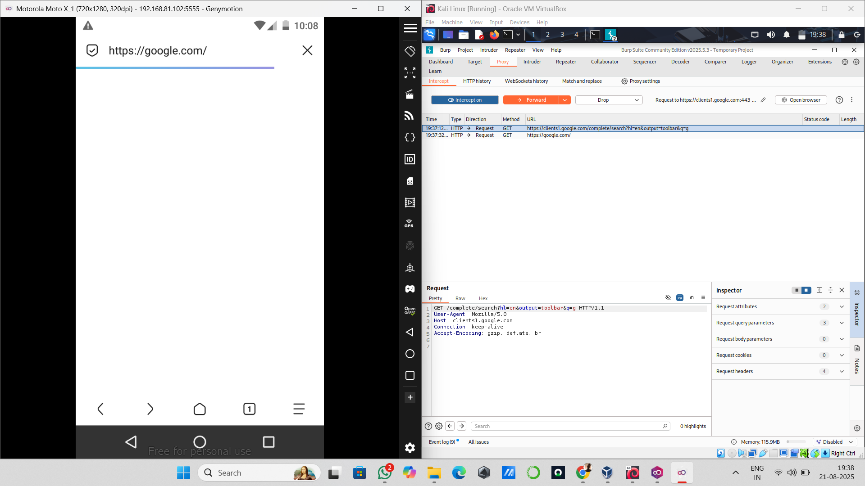
Signal:

Slide 11
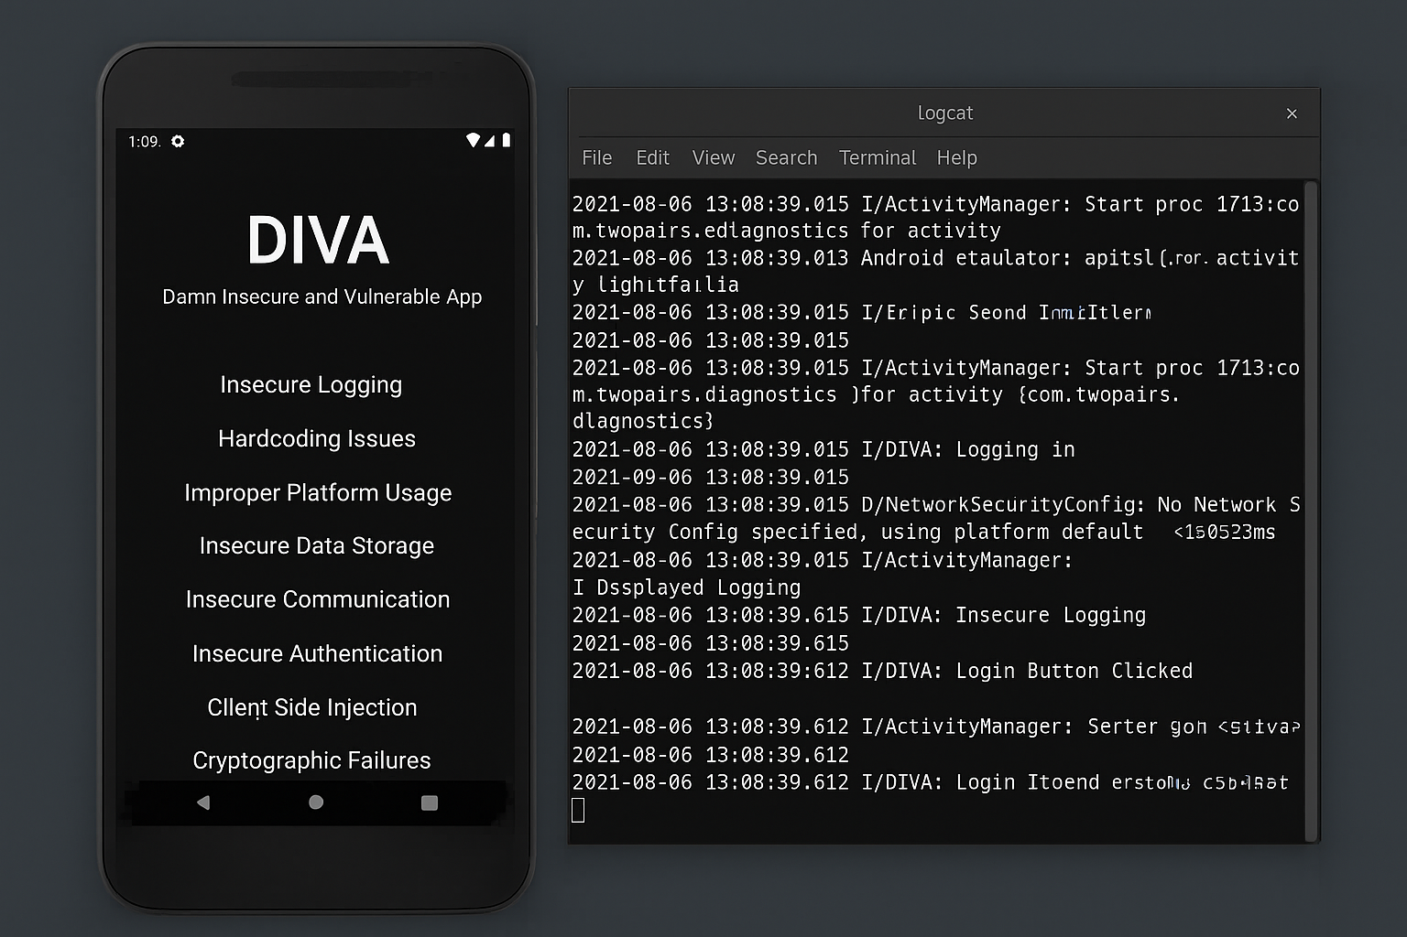
DIVA:

Slide 12



Slide 13
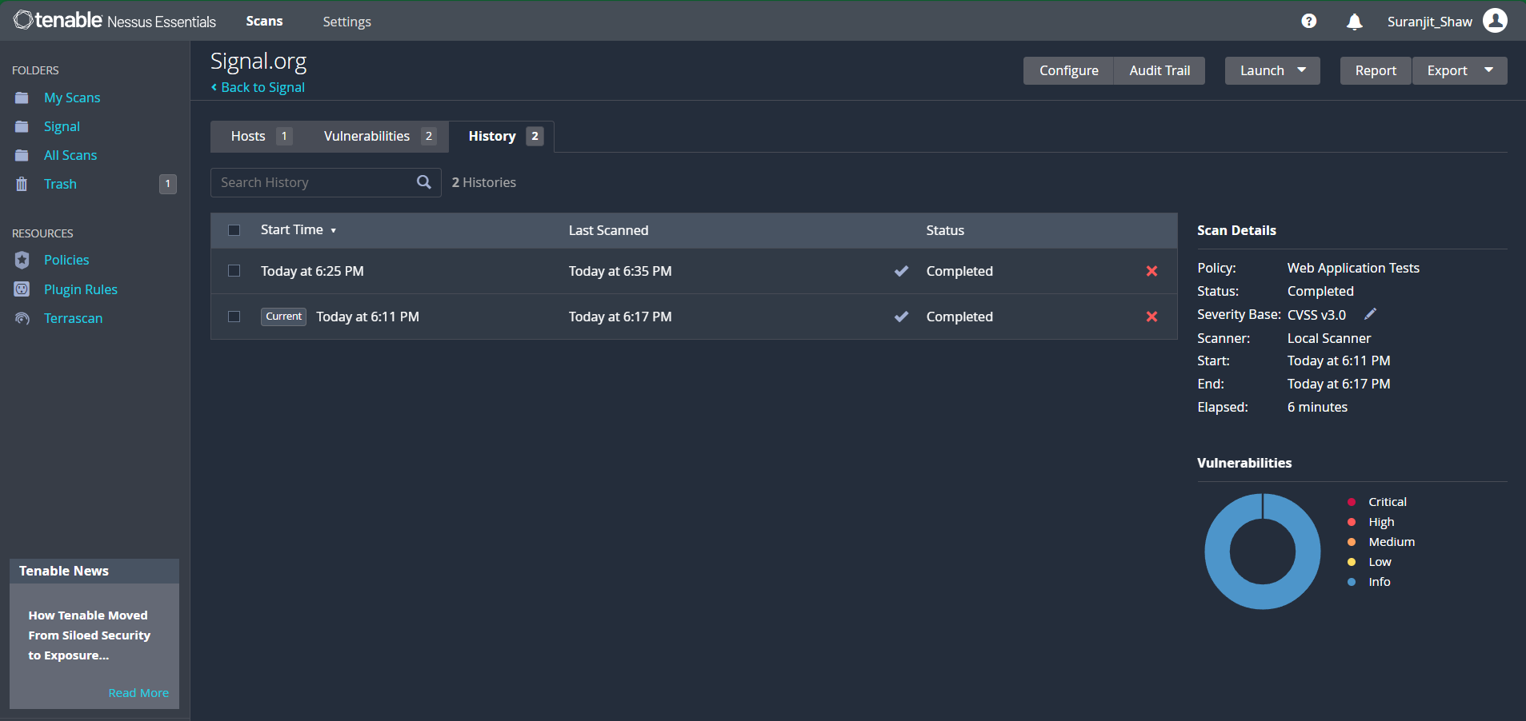
Signal:

Slide 14
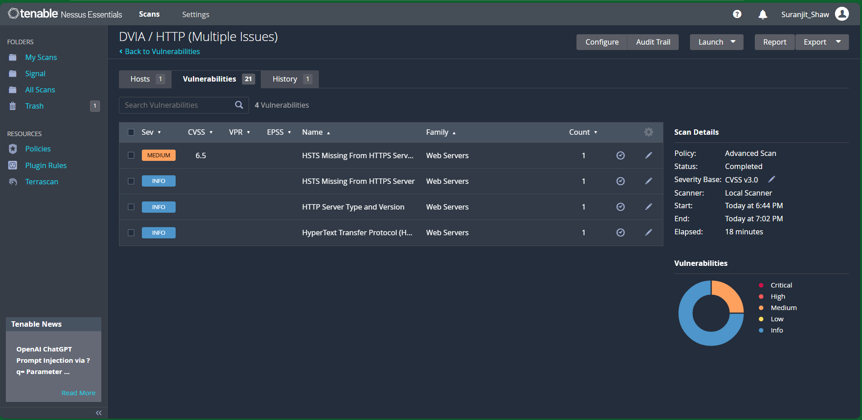
DIVA:

Slide 15
Mobile Security Gaurdian
OUR MODEL

Slide 16
Future Direction/ Solutions
Improved AI and Machine Learning: AI/ML enhances security testing through faster pattern and anomaly detection, lower false positives, and evolving to combat novel attack techniques. These technologies learn constantly, providing better precision and efficiency in detecting vulnerabilities.
DevSecOps Integration: Baking security checks into each phase of the development cycle makes applications more resilient. Automated tools, code review, and threat modeling make security a team sport, allowing for quicker and more secure releases.
Advanced Mobile Threat Detection: With changing threats, it requires specialized techniques to counter mobile OS and application vulnerabilities. Proactive measures and new techniques counter advanced attacks, safeguard user data, and provide secure mobile environments.

Slide 17
Conclusion
Critical Role in Mobile Security – Automated security testing is vital to discover and reduce mobile application vulnerabilities as threats become increasingly sophisticated.
Challenges Exist – False positives/negatives, heterogeneous mobile environments, and dynamic cyber threats stifle efficiency.
Need for Advancements – AI/ML, mobile-specific solutions, and CI/CD pipeline integration are needed to address existing deficiencies.
Future Directions – High accuracy, improved reporting, visualizing, and support for new technologies will make security testing more robust.
Ultimate Goal – To establish a solid framework that guarantees secure, reliable, and resilient mobile apps

Slide 18
THANK YOU!
As we look to the future, these technologies will play a crucial role in shaping a better world for generations to come.

Slide 19


